Slide 1
Managing International Assignments
Session 10/10

Slide 2
Session Outline
Why do companies need IAs?
Why do individuals want to go on IAs?
Why do IAs fail?
Managing IAs
Selecting International Assignees
Preparing IAs
Rewarding IAS

Slide 3
Why do companies need IAs?

Slide 4

Why companies have IAs
Edstrom and Galbraith (1977) identified three reasons for expatriation:
When qualified local country nationals are not available, particularly in developing countries, expatriates were used to fill positions
Expatriation is a means of developing individual employees
Expatriates can be utilized as a means of organizational development (e.g. transfer knowledge between subsidiaries) and to modify and sustain organizational structure and decision processes

Slide 5
Why companies have IAs
Pucik (1992) building on Edstrom and Galbraith (1977) defines 2 types of assignments:
Demand-driven (position filling or control)
Learning-driven (individual or organization development)

Slide 6
Why is this revelant?
In learning-driven assignments, the expatriate changes his/her frame of reference to adapt to the new environment and adapts his/her behaviour to meet the requirements of the new environment.
In demand-driven assignments, subsidiary subordinates are expected to absorb the new demands of the expatriate manager and change their frames of reference to meet the transferred manager’s expectations
Recruitment sources for Expatriates (PCN; HCN; TCN)
Selection Criteria
Expatriate development

Slide 7
Why do employees seek IAs?

Slide 8


Why employees want to take an IA?
Dickmann, M., Doherty, N., Mills, T. and Brewster, C. (2008). Why do they go? Individual and corporate perspectives on the factors influencing the decision to accept an international assignment. International Journal of Human Resource Management, Vol. 19 No. 4, pp. 731–751.

Slide 9
Why employees want to take an IA?
Career development
Personal development
Financial incentives (although research suggests that compensation packages offered are no longer as attractive as they once were)
The nature of IAs is also changing (shorter assignments, inpatriation, etc.)
There are now many self-initiated expatriates available locally
The adventure of living in a new country

Slide 10
Why do IAs fail?

Slide 11
Expatriate Failure
There is a very high failure rate of IAs (varies according to country of origin and destination)
Failure has been defined as “assignments from which expatriates had to be brought back home earlier than planned as a result of problems experienced by themselves or their families, or by problems they have created for the organisation” (Brewster, 1988: 20)
We also need to consider underperforming expatriates who end up completing their assignments

Slide 12
Language issues
Is English the lingua franca in the organization? Or the parent country language? Or are local languages used in subsidiaries?
CHALLENGES AT WORK
Communication between workers in MNCs is often hindered by language barriers issue (particularly in global teams)
Workers have different language skills and this not only affects communication but also chances of career progression
CHALLENGES OUTSIDE WORK
Expatriates have a social life in which they interact with locals. Language can be a very significant barrier which may prevent socialization and lead to assignment failure

Slide 13
Family issues
Growth of dual earner couples and increasing participation of
women in the labour market
Career patterns of expatriates’ partners (Forster, 2000)
Before the move
After the move
Part-time
32%
Part-time
9%
Full-time
34%
Full-time
11%
Not employed
34%
Not employed
80%
Forster, N. (2000). The myth of the'international manager'. International Journal of Human Resource Management, 11(1), 126-142.

Slide 14
Maintenance of ties with HQ
Loss of social capital and access to key organizational networks is usually a concern for expatriates who fear that this will have a negative impact in their future career
A study by Yao et al (2014) shows how Chinese expatriates are concerned about maintaining their guanxi in HQ
“the network of informal relationships within a social group or, at an individual level, to a particular individual’s informal relationship ties with other individuals within this social group” (Bozionelos and Wang 2006, p.1535).”
Yao, C., Thorn, K., & Doherty, N. (2014). Boundarylessness as a dynamic construct: the case of Chinese early career expatriates. Career Development International, 19(6), 683-699.

Slide 15
Expatriate Adjustment
Adjustment is “a normal process of adaptation to cultural stress involving such symptoms as anxiety, helplessness, irritability, and longing for more predictable and ratifying environment” (Church, 1982)
Work adjustment
Adjustment to job responsibilities, supervision, and performance expectations;
Interaction adjustment
Adjustment to socializing and speaking with nationals of the host country;
General living adjustment
Adjustment to housing, food, shopping, etc.
The quality of expat (and their families’) adjustment is significantly associated with the success of IAs

Slide 16
Expatriate Adjustment literature
Attitudinal Outcomes
Intention to remain on the assignment
Job satisfaction
Organizational commitment
Perceptions of cultural adjustment
Expatriate
Adjustment
Performance Outcomes
Task Performance
OCBs
Hechanova, R., Beehr, T. A., & Christiansen, N. D. (2003). Antecedents and consequences of employees’ adjustment to overseas assignment: a meta‐analytic review. Applied Psychology, 52(2), 213-236.
Thomas Hippler, Paula M. Caligiuri, Johanna E. Johnson & Nataliya Baytalskaya (2014) The development and validation of a theory-based expatriate adjustment scale, The International Journal of Human Resource Management, 25(14): 1938-1959.

Slide 17
RECAPPING
There is a high rate of failure of IAs
MNCs rely on the success of IAs to expand their business, communicate, develop and control subsidiaries
Selecting, developing and rewarding expatriates is very important for MNCs

Slide 18
The process of selecting International Assignees

Slide 19
The process of selecting International Assignees
Who to target (PCN? HCN? TNC?)
Realistic previews for international assignments
Selection criteria
Competences
Skills
Personality

Slide 20
Who to target?
Company strategy
Talent availability
Nature of the assignment

Slide 21
HR Strategy in MNCs: Staffing
Ethnocentric approach
Polycentric approach
Geocentric approach
Regiocentric approach
Parent country nationals (PCN) focused
Allows good communication between HQ & Subsidiary
Causes resentment (local employees see only foreign ones taking the lead), expensive
Host country nationals (HCN) focused
Allows flexibility
Lacks control
Best person for the job e.g. HCN, PCN, Third Country nationals (TCN)
Global integration
Lacks attention to local issues
Operations divided into independent regions
Combines benefits of ethno/polycentric
Also combines their problems!

Slide 22
National/sectoral differences in staffing choices
% of PCN subsidiary managing directors (Harzing 2001)

Slide 23
Selecting International Assignees

Slide 24
Realistic previews for international assignments
International Assignees often do not have realistic expectations about the IA
In order to reduce the risk of IA failure, HR managers need to inform the potential expatriate of the downsides of the IA
E.g. living conditions; isolation
A very useful source are repatriates who can meet with prospective expatriates to discuss their experiences

Slide 25
Selection of international assignees
Practice demonstrates that the selection of IAs is not that different from that of any other employee/position
Recommendations from peers and supervisors
Skills and competencies
However, International Assignments (particularly long-term and learning driven) are more about job contexts than job descriptions
The selection for International Assignments requires that candidates are assessed on a whole range of other critical elements
Personality characteristics
Language skills
Family circumstances
Prior International Experience

Slide 26
Personality characteristics
The big 5 (associated with positive results)
Extroversion – Important to establish interpersonal relationships with host nationals and other international assignees
Agreeableness – Important to form social relationships
Conscientiousness – Important to instil confidence; ethical behaviour
Emotional Stability – Important to cope with the cultural shock and adjust to the environment
Openness to experience – Important to fit in the new environment
Other important traits
Self-efficacy
Resiliency
Tolerance for ambiguity

Slide 27
Language skills
There is a logical consensus that language skills are associated with positive international assignee adjustment
Note: While language skills are fundamental for contact with host country nationals they are not a guarantee of full adjustment
People might know the language and which behaviours to display and only be superficially adjusted to the new environment

Slide 28
Prior International Experience
The more contact international assignees have with host nationals and the host culture, the greater their cross-cultural adjustment
International experience in general should favour international assignees’ ability to more easily adjust to other cultures

Slide 29
Family circumstances
Family circumstances are one of the key factors facilitating or hindering expatriate adjustment and the success of IAs
However, in many countries (e.g. UK) it is illegal to ask about family circumstances in the context of selection due to issues of fairness
This can be addressed indirectly (e.g. offering pre-departure training for family members)

Slide 30
Preparing International Assignees

Slide 31
Key cross-cultural training interventions
Pre-departure cross-cultural orientation
Cultural awareness training
Diversity training
Traditional education in international management
Cross-national coaching or mentoring
Language training

Slide 32
Pre-departure cross-cultural orientation
Aims to help an international assignee learn the basics to live and work comfortably in the host country:
Currency
Public transportation
Working hours
Etc…

Slide 33
Cultural awareness training
It aims to help expatriates gain awareness of their own culture as a means of helping them gain appreciation for the cultural differences they will face in the host country.

Slide 34
Diversity training
Aims to help international assignees gain awareness of key diversity issues they are more likely to face and increase their ability to understand and appreciate multiple cultural perspectives

Slide 35
Traditional education in international management
University or specific training programmes that can be offered as a part of a larger developmental plan aiming to increase international business acumen and knowledge.

Slide 36
Cross-national coaching or mentoring
Cross-national coaches and mentors can help international assignees build cultural awareness, work on cultural ‘blind-spots’ and help them develop competencies for becoming effective in an international environment.
Cross-national coaches can also be hired for assistance with a specific task such as delivering an important speech in another country or negotiating an international joint venture

Slide 37
Language Training
It is fundamental for assignments where people are immersed in a foreign culture and need to interact with host nationals in work and non-work related contexts
Language training improves expatriate adjustment and can have a positive effect on expatriate performance.

Slide 38
Expatriate Compensation

Slide 39
International Compensation Components
Base Salary:
Foundation of international compensation package;
Currency considerations;
Allowances:
Cost of Living Allowance (COLA);
Exchange rate protection programmes:
Housing, home leave, education, relocation allowances, spousal assistance;
Benefits:
E.g. Vacation and special leave (paid time off)
Foreign service inducement/hardship premium:
Commonly paid to PCNs and TCNs;
Amounts to approx. 5% – 40% of base pay;

Slide 40
Need to consider Hardship
1. Remoteness – geographical isolation, travel difficulties, lack of cultural and recreation facilities, unavailability and poor quality of food and other essentials;
2. Climate and geophysical conditions – extreme weather conditions, risk of natural disaster, pollution;
3. Health risks - lack or poor standard of medical facilities, risk of disease, poor infrastructure (e,g, provision of water, sanitation etc.);

Slide 41
Need to consider Hardship
4. Political concerns - government activities, terrorism, corruption, human rights infractions, scarce availability of home-country representation;
5. Crime - risk to individuals or property, quality of policing;
6. Family-unfriendly conditions - poor educational facilities, poor housing quality, poor communications infrastructure.

Slide 42
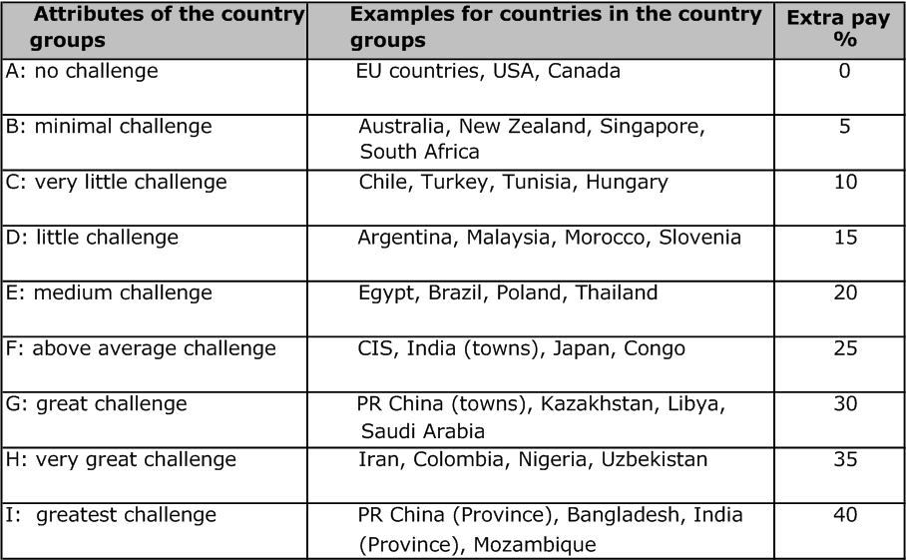
Extra pay for Western expatriates in proportion to challenge posed by host country (in % of net salary)
Need to consider Hardship
(DGfP 1995: 77)

